Slide 1
ANALYSIS OF NEW YORK CITY AND TORONTO FOR SUTABILITY OF BUSINESS START UPS

Slide 2
PROJECT IDEA
This project aims at profiling the neighborhoods of Toronto and New York City to come up with the best location for starting a new restaurant.

Slide 3
PROJECT DATA
New York Data: https://geo.nyu.edu/catalog/nyu_2451_34572
Toronto data exists in the week 1 assignment of the course where we scrapped the Wikipedia website.

Slide 4
Data COLLECTION
The required data is collected in the first parts of the Jupyter Notebook. Toronto boroughs and neighborhoods are scrapped from the Wikipedia link, using the BeautifulSoup package.

Slide 5
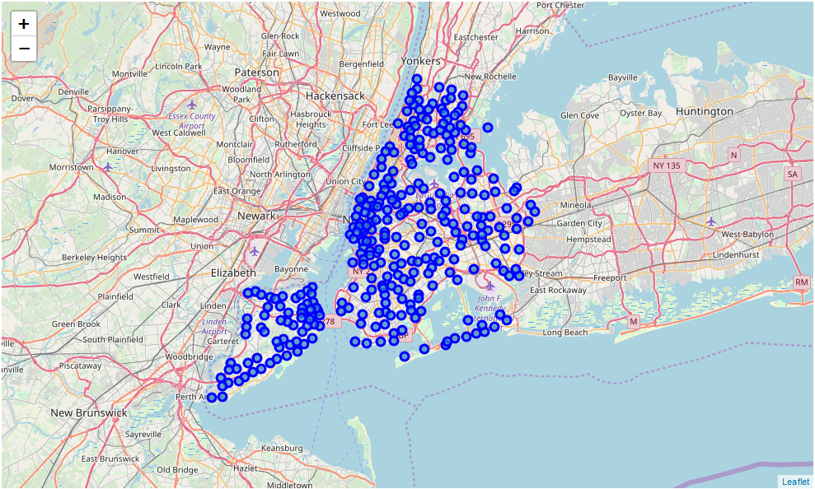
TORONTO NEIGHBORHOOD VISUALIZATION

Slide 6
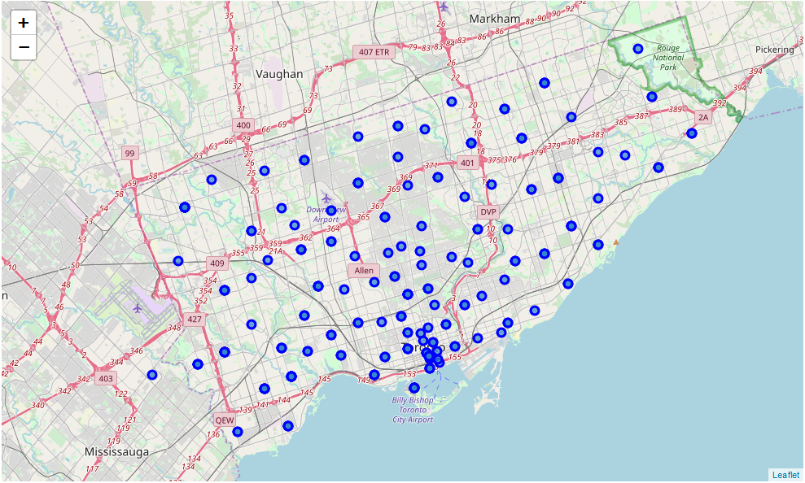
New York Neighborhoods Visualization

Slide 7
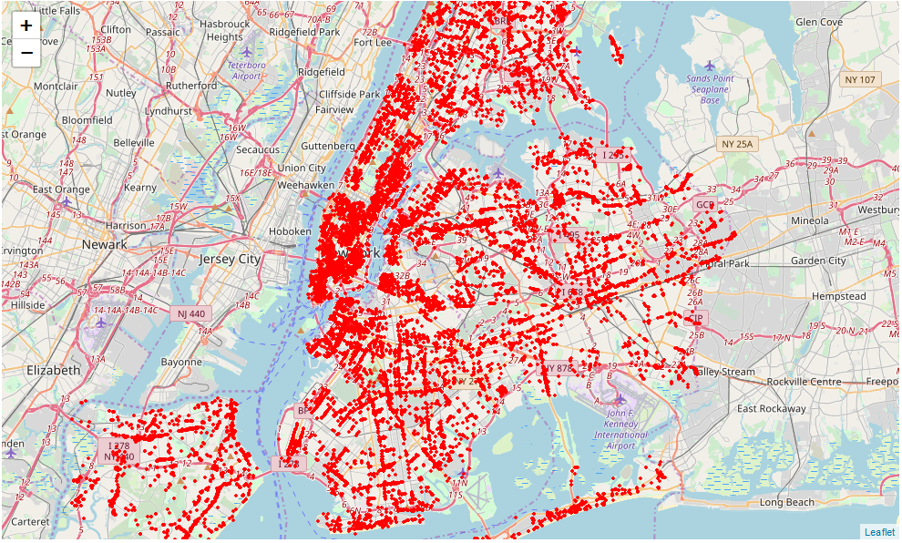
NEW YORK VENUE VISUALIZATION

Slide 8
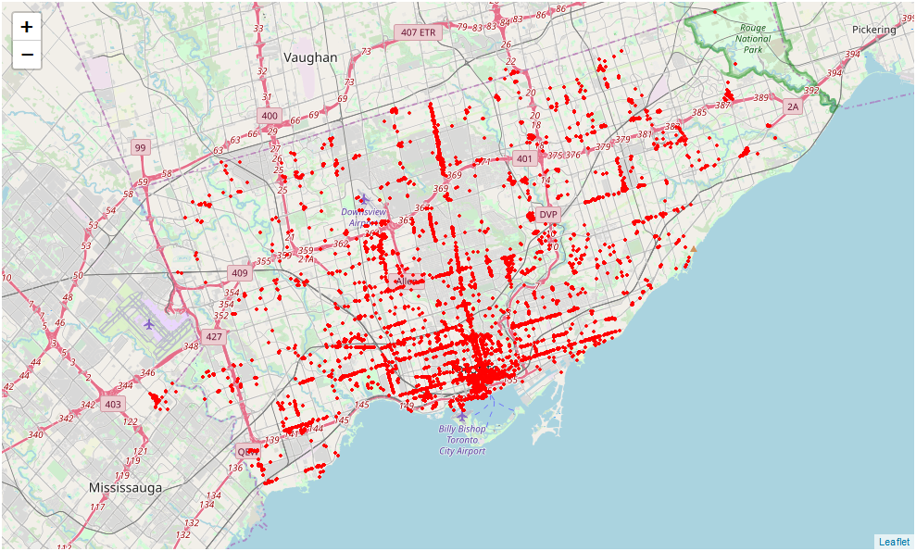
Toronto Venue Visualization

Slide 9
VENUE ANALYSIS
The "ny_venues" dataframe has 20537 venues and 466 unique venue types, and the "to_venues" dataframe has 9306 venues and 334 unique venue types.
The proportion in number of venues are expected, considering the population and population density of these two cities.
However, New York City has slightly more variety of venues than Toronto. This is expected as the population in New York City is much larger than in Toronto, and also the number of neighborhoods in NYC are many.

Slide 10
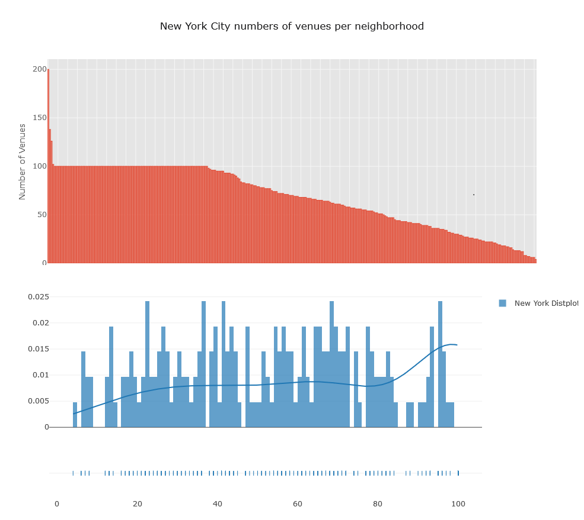
New YORK CITY NUMBERS OF VENUES PER NEIGHBORHOOD GRAPHS

Slide 11
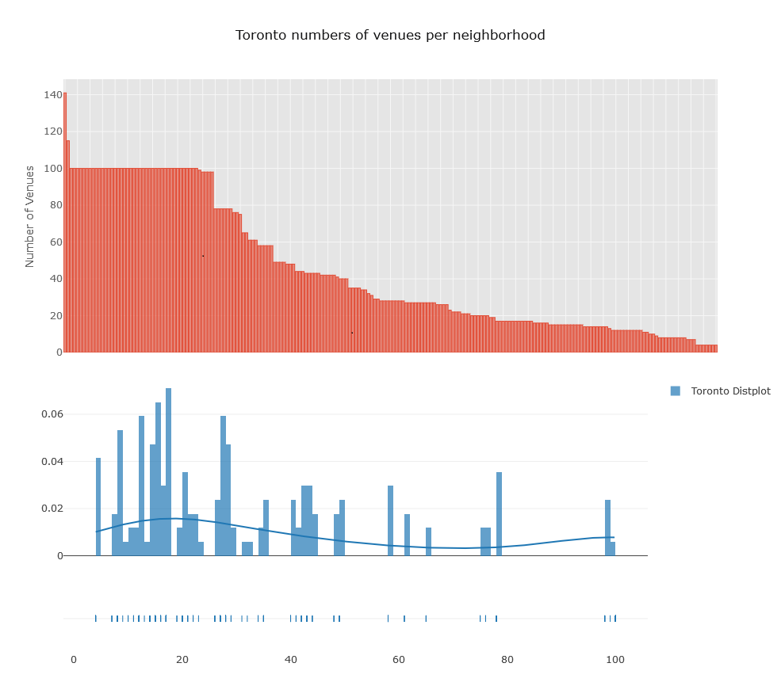
TORONTO NUMBER OF VENUES PER NEIGHBORHOOD GRAPHS

Slide 12
Analysis of venues per neighborhood.
As it can be noted, New York City have several neighborhoods with "100" venues.
Both cities have some neighborhoods with several venues, indicating that there are agglomerations of businesses of the same kind at certain locations that will be further studied.
However, some locations have fewer restaurants as compared to others and that is what should be our focus.

Slide 13
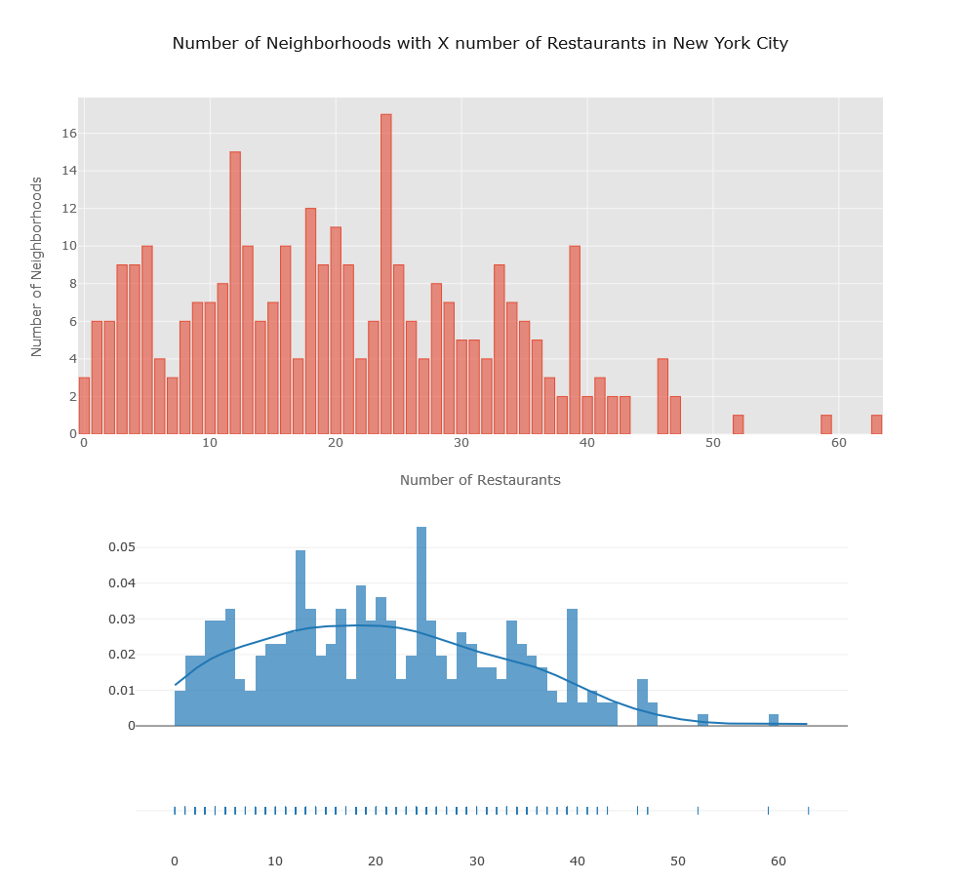
COMPARING THE NUMBER OF RESTAURANTS IN NYC AND TORONTO PER NEIGHBORHOOD.

Slide 14
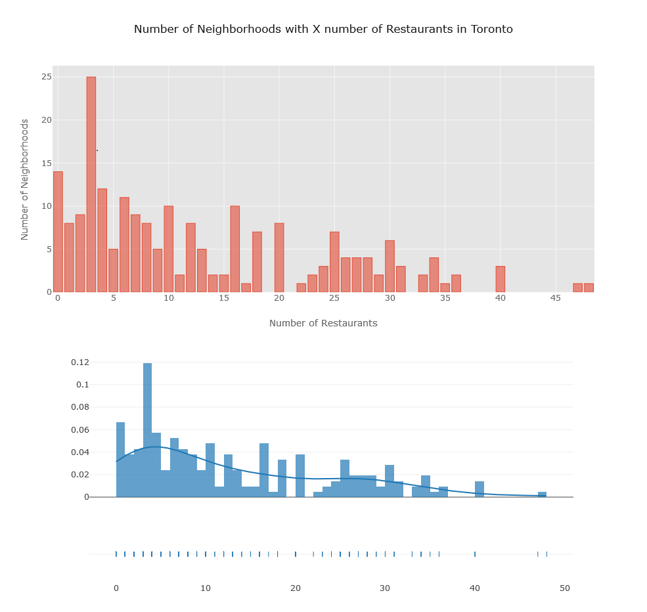

Slide 15
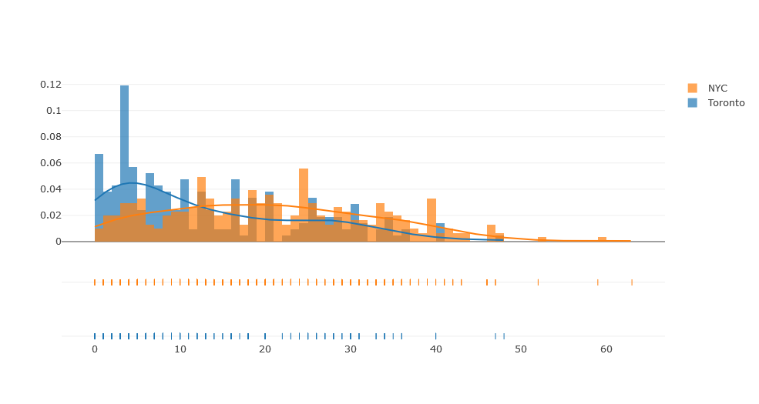
ANALYSIS OF THE NUMBER OF RESTAURANTS PER NEIGHBORHOOD FOR THE TWO CITIES.
Comparing both distributions, we can conclude that the restaurant business in New York City is much more saturated than in Toronto, as only few neighborhoods have been "taken" by these establishments.

Slide 16
Bars and Clubs Distribution in Each City.
The Bars and Clubs distribution are much more different between Toronto and NYC.
In NYC this kind of business seems also saturated, with lots of places distributed between several neighborhoods, while in Toronto there are much more inequality in bars and club distribution between the neighborhoods.
So, In Toronto this kind of business is concentrated in few neighborhoods.
The visualization is shown in the next slide.

Slide 17
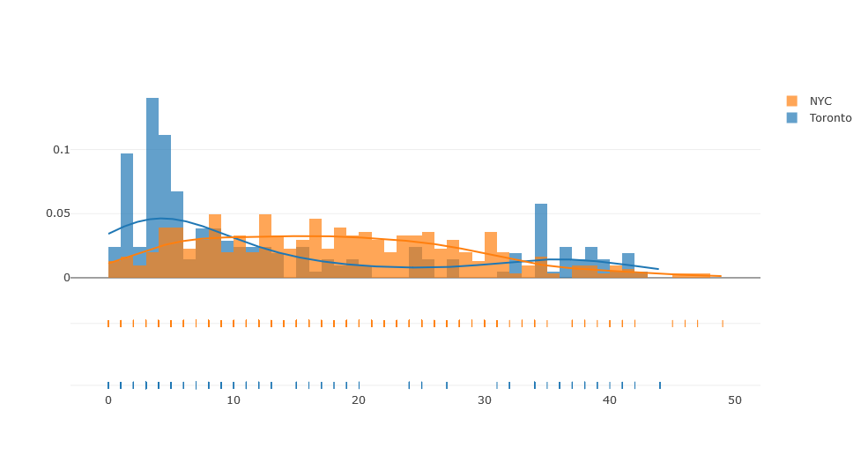

Slide 18
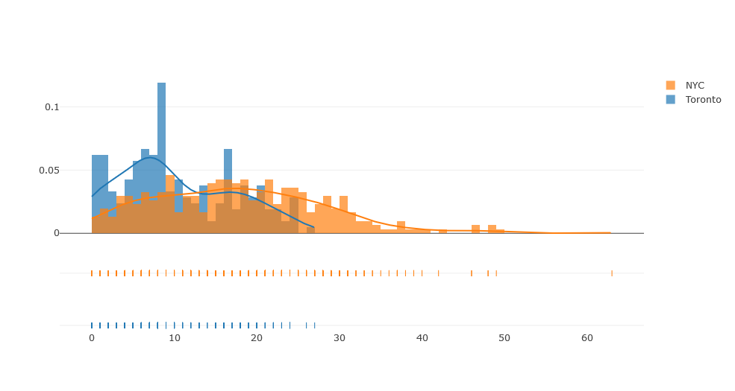
General Services Distribution in Each City.
The general services distribution is somewhat similar between the two cities, but still follows the same pattern than the previous ones - New York seems more saturated while in Toronto some neighborhoods have a deficiency of services.

Slide 19
Good neighborhoods for establishing new restaurant venues in Toronto (possible untapped markets):
Richview Gardens, Roselawn, Rouge, Royal York South West, Scarborough Town Centre, Silverstone, Parkview Hill, Mimico NW, Mount Olive, Oriole, Maryvale, South Steeles, Wexford Heights, Wilson Heights, Woodbine Gardens, York Mills West, Wexford, Thorncliffe Park, Thistle town, South of Bloor, St. Phillips, Steeles West, The Beaches West, The Queensway West, Martin Grove Gardens, Cliffside West, Downsview North, Downsview Northwest, Downsview West, East Birch mount Park, Dorset Park, Albion Gardens, Bathurst Manor, Beaumont Heights, Bedford Park, Birch Cliff, Caledonia-Fairbanks, Cedar brae, Jamestown, Kennedy Park, Kingsview Village, Kingsway Park South West, Lamoreaux West, Lawrence Heights, Lawrence Manor, Lawrence Manor East, Leaside, Malvern, Ion view, India Bazaar, Glencairn, Henry Farm, Hillcrest Village, Humbergate, Fairview

Slide 20
Good neighborhoods for establishing new restaurant venues in NYC (not so much competition and good demand)
Oakland Gardens, North Side, North Riverdale, North Corona, Noho, Prospect Heights, Pelham Parkway, New Brighton, Murray Hill, Manhattanville, Manhattan Valley, Manhattan Beach, Lower East Side, Murray Hill, Morningside Heights, Midtown South, Ravenswood, Upper West Side, Turtle Bay, Tudor City, Tottenville, Throgs Neck, Sunnyside Gardens, Williamsburg, Whitestone, West Village, West Brighton, Sunnyside, Stuyvesant Town, Roosevelt Island, Rockaway Beach, Riverdale, Ridgewood, Schuylerville, Sheepshead Bay, Steinway, South Side, South Ozone Park, City Island, Chinatown, Central Harlem, Bushwick, Clifton, Clinton Hill, Bayside, Bay Ridge, Astoria, Annadale, Bedford Stuyvesant, Briarwood, Bergen Beach, Woodside, Hamilton Heights, Great Kills, Gramercy, Kingsbridge, Jackson Heights, Inwood, Hunters Point, Elmhurst, Edgewater Park, East Village, East Harlem, Fieldston, Fort Hamilton, Fort Greene, Forest Hills Gardens, Flushing, Flatbush, Yorkville

Slide 21
CONCLUSION
With this analysis and the documented report, an investor will find the key insights and identify potential ‘safe bets’ in investment in restaurant business in the two analyzed cities.

Slide 22
THANK YOU

